Slide 1
Finite Automata with Output
Shakir Ullah Shah

Slide 2
Agenda
Moore Machines
Mealy Machines

Slide 3
There are two type of machines:
Recognizer (Accept/reject)
Generator (output)
There are two types of machines with output.
Moore machine and
Mealy machine

Slide 5
Moore Machine Definition
Moore machine is a collection of five things:
A finite set of states q₀, q₁, q₂, ..., where q₀ is designated as the start state.
An alphabet of letters for forming the input string ∑= {a, b, c, …}.
An alphabet of possible output characters Γ = {0, 1, 2, …}.
A transition table that shows for each state and each input letter what state is reached next.
An output table that shows what character from Γ is printed by each state as it is entered.

Slide 6
Notes
To keep the output alphabet separate from the input alphabet, we give it a different name Γ (instead of ∑) and use number symbols {0, 1, …} (instead of {a, b, …}).
We refer to input symbols as letters, whereas we refer to output symbols as characters.
We adopt the policy that a Moore machine always begins by printing the character dictated by the mandatory start state. So, if the input string has 7 letters, then the output string will have 8 characters, because it includes 8 states in its path.

Slide 7
Defining a Language
To change FA into a Moor Machine
Name each state
Name start state q0
Output 0 in all non-final states
Output 1 in all final states
A string is accepted if after it has been completed read in the last letter printed 1.

Slide 8
Example: Moore machine defined by a table
Input alphabet: ∑ = {a, b}
Output alphabet: Γ = {0, 1}
Names of states: q₀, q₁, q₂, q₃ with q₀ being the start state.
Transition and output table (combined):
Old States | New states after reading |  | Output by Old State
 | a | b
q₀ | q₁ | q₃ | 1
q₁ | q₃ | q₁ | 0
q₂ | q₀ | q₃ | 0
q₃ | q₃ | q₂ | 1

Slide 9
Pictorial Representation
Moore machines have pictorial representations similar to FAs.
The difference is that inside each state, in addition to the state name, we also specify the output character printed by that state, using the format state – name/output.
Hence, the Moore machine in the above example has the following pictorial representation:

Slide 10
Example
We indicate the start state by an outside arrow since there is no room for the usual - sign.
Given the input string abab, the output sequence is 10010.
Note that the length of the output string is one longer than the length of the input string.

Slide 11
Input |  | a | b | b | a | b | b | b | a
State | q₀ | q₁ | q₁ | q₁ | q₃ | q₂ | q₃ | q₂ | Q₀
output | 1 | 0 | 0 | 0 | 1 | 0 | 1 | 0 | 1
It may be noted that the length of output string is 1 more than that of input string as the initial state prints out the extra character 1, before the input string is read.

Slide 12
Example
Suppose we are interested in knowing exactly how many times the substring aab occurs in a long input string. The following Moore machine will count this for us:

Slide 13
Example
Every state of this machine prints out a 0, except for q3, which prints a 1.
To get to q₃, we must have come from q₂ and have just read a b. To get to q₂, we must have read at least two a’s in a row.
After finding the subtring aab and tallying a 1 for it, the machine looks for the next aab. Hence, the number of 1’s in the output string is exactly the number of substrings aab in the input string.
It accepts all words that end with aab.

Slide 14
Melay machine Definition
A Mealy machine is a collection of four things:
1. A finite set of states q₀, q₁, q₂, ..., where q₀ is designated as the start state.
2. An alphabet of letters for forming the input string ∑ = {a, b, …}.
3. An alphabet of possible output characters Γ = {0, 1, …}.
4. A pictorial representation with states represented by small circles and directed edges indicating transition between states.
Each edge is labeled with a compound symbol of the form i/o where i is an input letter and o is an output character.
Every state must have exactly one outgoing edge for each possible input letter.
The edge we travel is determined by the input letter i. While traveling on the edge, we must print the output character o.

Slide 15
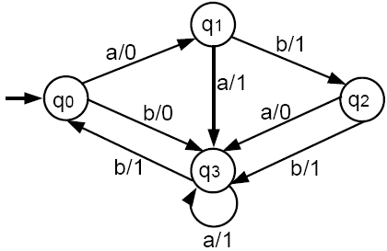
Example
Given the input string aaabb, the output is 01110.
In a Mealy machine the output string has the same number of characters as the input string has letters.

Slide 16
A Mealy machine does not define a language by accepting and rejecting input strings: It has no final states.
However, there is a sense in which a Mealy machine can recognize a language, as we will see later.
Note the following notation simplification:

Slide 17
Example
The following Mealy machine prints out the 1’s complement of an input bit string.
This means that it will produce a bit string that has a 1 whenever the input string has a 0, and a 0 whenever the input has a 1.
If the input string is 001010, the output will be 110101

Slide 18
Example
Let consider a Mealy machine, called increment machine, which reads a binary number and prints out the binary number that is one larger.
Assume that the input bit string is a binary number fed in backward; that is, unit digit first, then 2’s digit, 4’s digit, etc.
The output string will be the binary number that is one greater and that is generated right to left.
The machine will have 3 states: start, owe-carry and no-carry. The owe-carry state represents the overflow when two bits of 1’s are added, we print a 0 and we carry a 1.

Slide 19
Example contd.
From the start state, if we read a 0, we print a 1 (incrementing process), and we go to the no-carry state. If we read a 1, we print a 0 (incrementing) and we go to the owe-carry state.
At any point in the process, in we are in the no-carry state, we print the next bit just as we read it and remains in no-carry.
However, if we are in the owe-carry state and read a 0, we print a 1 and go to no-carry. If we are in owe-carry and read a 1, we print a 0 and we loop back to owe-carry.

Slide 20
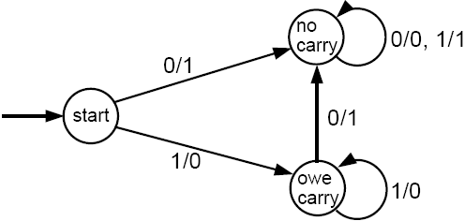
Example contd.
Let the input string be 1011 (binary representation of 11).
The string is fed into the machine as 1101 (backwards).
The output will be 0011, which when reversed is 1100 and is the binary representation of 12.
In Mealy machine, output length = input length. Hence, if input were 1111, then output would be 0000 (overflow situation).

Slide 21
Example
Although a Mealy machine does not accept or reject an input string, it can recognize a language by making its output string answer some question about the input.
Consider the language of all words that have a double letter (aa or bb) in them.
We can build a Mealy machine that can take an input string of a’s and b’s, and print out an output string of 0’s and 1’s such that if the n-th output character is a 1, it means that the n-th input letter is the second letter in a pair of double letters.
The complete picture of this machine is as follows:

Slide 22
If the input string is ababbaab, the output will be 00001010.
This machine recognizes the occurrences of aa or bb.
Note that the triple letter word aaa produces the output 011 since the second and third letters are both the back end of a pair of double a’s.

